Slide 1
Advanced Microcontrollers & Applications (EC-506)
Class: ECE- 5th Semester
Academic session: Aug-Dec, 2020

Slide 2
(SECTION-B)
Open Source Embedded Development Board (Arduino)

Slide 3
Introduction to Arduino
Arduino is an open source platform used for building electronics projects.
Arduino consists of both a physical programmable circuit board or microcontroller and a software, IDE (Integrated Development Environment) that runs on the computer.
It is used to write and upload computer code to the physical board.

Slide 4
Arduino boards are equipped with sets of digital and analog input/output pins, USB connection which is used for loading programs from computers, power jack, reset button etc.

Slide 5
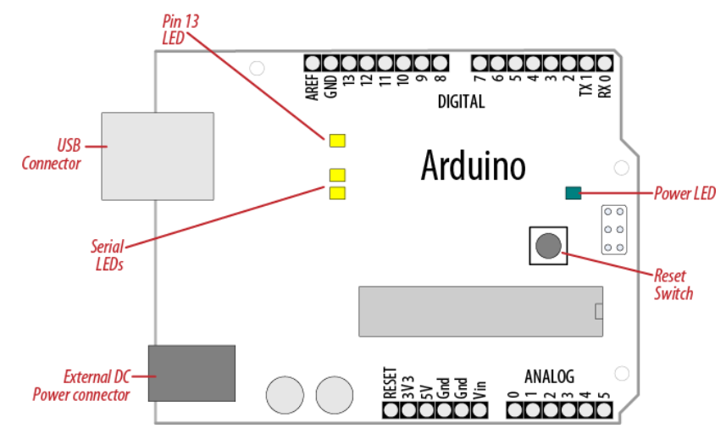
Basic Arduino UNO board (Hardware)

Slide 6
Arduino UNO board with Atmega328 Microcontroller

Slide 7
Atmega328 Microcontroller and its pin mapping with Arduino board pins

Slide 8
Arduino Bootloader
It is the first program which executes when a device is connected to a power supply.

Slide 9
Arduino IDE Features
It is an open source software.
Easy to write code and upload it to the physical board.
Easy to learn programming language with its inbuilt functions.
Runs on windows, Mac OS and Linux.
This software can be used with any arduino board.

Slide 10
Arduino IDE ( Software)
A program written with the IDE for Arduino is called a sketch.
The IDE enables to write and edit code and convert this code into instructions that Arduino hardware understands. The IDE also transfers those instructions to the Arduino board (a process called as uploading).

Slide 11
Arduino IDE (Software)
The Arduino IDE supports the languages C and C++ using special rules of code structuring.
It consists of only two functions, setup and loop.
The setup function is used to initialize variables, input and output pin modes and other libraries needed in the sketch.
After setup has been called, function loop is executed repeatedly in the main program. It controls the board until the board is powered off or reset.

Slide 12
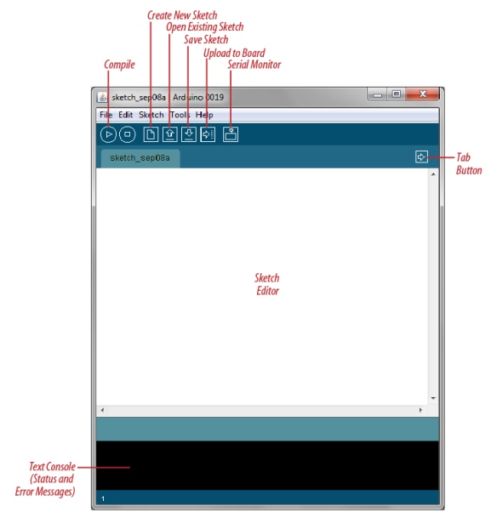
Arduino IDE (Software)

Slide 13
Arduino programming Language

Slide 14
Interface Digital and Analog I/O Devices
(Arduino Interfacing)

Slide 15
Communication Protocols
Communication protocols are defined to achieve data exchange.
Each protocol can be categorized into one of the two categories:
Serial
OR
Parallel

Slide 16
Parallel Communication:
Useful in shorter distances ( upto several meters).
Example Parallel connection between Arduino and peripherals via I/O ports.
Long distance communication is not possible.

Slide 17
Advantages and Drawbacks of Parallel Communication
Faster than serial, easy to implement .
Parallel interfaces transfer multiple bits at the same time.
Disadvantages:
Requires many input/output (I/O) ports and lines.

Slide 18
Serial Communication
Sent and receive data through stream of bits.
This stream of bits is governed by set of rules called as protocol.
It is a set of rules, which must be applied such that the devices can correctly interpret data they mutually exchange.
Arduino automatically takes care of this, so that the work of the programmer/user is reduced to simple write (data to be sent) and read (received data).

Slide 19
Types of Serial communication
Synchronous :
Devices that are synchronized use the same clock and their timing is in synchronization with each other.
Asynchronous:
Devices that are asynchronous have their own clocks and are triggered by the output of the previous state.
UART (Universal Asynchronous Receiver Transmitter) module is asynchronous.

Slide 20
The asynchronous serial protocol has a number of built-in rules. These rules are nothing but mechanisms that help ensure robust and error-free data transfers.
Synchronization bits:
Two or three bits transferred with each packet of data.
They are start bit and stop bit.
The start bit is always indicated by an idle data line going from 1 to 0, while the stop bit(s) will transition back to the idle state by holding the line at 1.

Slide 21
Data bits:
The amount of data in each packet can be set to any size from 5 to 9 bits.
Certainly, the standard data size is your basic 8-bit (byte), but other sizes have their uses.
A 7-bit data packet can be more efficient than 8, especially if you are just transferring 7-bit ASCII characters.

Slide 22
Parity bits:
The user can select whether there should be a parity bit or not, and if yes, whether the parity should be odd or even. The parity bit is 0 if the number of 1’s among the data bits is even. Odd parity is just the opposite

Slide 23
Baud rate:
The term baud rate denotes number of bits transferred per second (bps).
It is usually required by the protocol that each byte is transferred along with several control bits.
It means that one byte in serial data stream may consist of 11 bits.
For example, if the baud rate is 300 bps then maximum 37 and minimum 27 bytes may be transferred per second.

Slide 24
Example
Arduino UART:
void setup()
{
Serial.begin(9600); //set up serial library baud rate to 9600
Serial.println("hello world"); //print hello world
}
void loop()
{ }

Slide 25
Code will make Arduino deliver output depending on the input provided.
Open the Serial monitor at the top right section of Arduino IDE.
Type anything into the top box of the Serial Monitor and press send or enter on your keyboard. This will send a series of bytes to the Arduino.
The following code returns whatever it receives as an input.

Slide 26
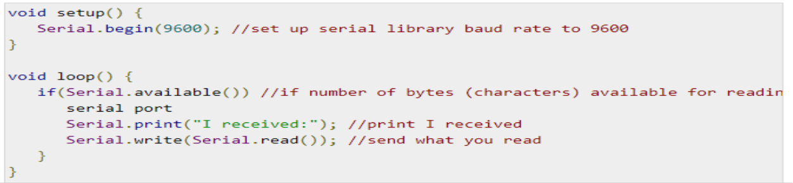
The following code will make Arduino deliver output depending on the input provided

Slide 27
Serial communication Protocols
I2C (Inter- Integrated Circuit) :
Inter-integrated circuit (I2C) is a system for serial data exchange between the microcontrollers and specialized integrated circuits of a new generation.
Used when the distance between them is short (receiver and transmitter are usually on the same printed board).
Connection is established via two conductors. One is used for data transfer and the other is used for synchronization (clock signal).

Slide 28
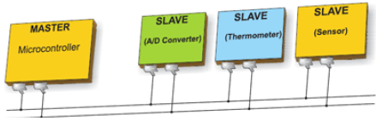
Schematic of I2C BUS
The address of I2C is 7 bits long. Theoretically allows 128 I2C addresses, however some addresses are reserved for special purposes, thus only 112 addresses are available with 7 bit scheme.

Slide 29
Working:
One device is always a master. It performs addressing of one slave chip before the communication starts.
Baud rate is usually 100 Kb/sec (standard mode) or 10 Kb/sec (slow baud rate mode). Systems with the baud rate of 3.4 Mb/sec have recently appeared.
The distance between devices, which communicate over an I2C bus is limited to several meters.

Slide 30
Arduino board I2C pins
The I2C bus consists of two signals − SCL and SDA.
SCL is the clock signal, and SDA is the data signal.
Master always generates the clock signal. Some slave devices may force the clock low at times to delay the master sending more data (or to require more time to prepare data before the master attempts to clock it out). This is known as “clock stretching”.
Following are the pins for Arduino boards −
Uno, Pro Mini {A4 (SDA), A5 (SCL)}

Slide 31
Arduino I2C Modes
Two modes - master code and slave code - to connect two Arduino boards using I2C.
Master Transmitter / Slave Receiver
Master Receiver / Slave Transmitter

Slide 32
Master Transmitter / Slave Receiver
Master Transmitter:
The following functions are used to initialize the Wire library and join the I2C bus as a master or slave. This is normally called only once.
Wire.begin(address) − Address is the 7-bit slave address in our case as the master is not specified and it will join the bus as a master.
Wire.beginTransmission(address) − Begin a transmission to the I2C slave device with the given address.
Wire.write(value) − Queues bytes for transmission from a master to slave device (in-between calls to beginTransmission() and endTransmission()).
Wire.endTransmission() − Ends a transmission to a slave device that was begun by beginTransmission() and transmits the bytes that were queued by wire.write().

Slide 33
Example
#include <Wire.h> //include wire library
void setup() //this will run only once
{
Wire.begin(); // join i2c bus as master }
short age = 0; // short storage size is 2 bytes (value range -32768 to 32767)
void loop()
{ Wire.beginTransmission(2); // transmit to device #2
Wire.write("age is = ");
Wire.write(age); // sends one byte
Wire.endTransmission(); // stop transmitting
delay(1000);
}

Slide 34
Slave receiver
The following functions are used −
Wire.begin(address) − Address is the 7-bit slave address.
Wire.onReceive(received data handler) − Function to be called when a slave device receives data from the master.
Wire.available() − Returns the number of bytes available for retrieval with Wire.read().This should be called inside the Wire.onReceive() handler.

Slide 35
Example
#include <Wire.h> //include wire library
#DEFINE SLAVEADDR 2
void setup()
{ //this will run only once
Wire.begin(2); // join i2c bus with address #2
Wire.onReceive(receiveEvent); // call receiveEvent when the master send any thing
Serial.begin(9600); // start serial for output to print what we receive }
void loop()
{ delay(250); } //-----this function will execute whenever data is received from master-----//
void receiveEvent(int howMany)
{ while (Wire.available()>1) // loop through all but the last
{ char c = Wire.read(); // receive byte as a character
Serial.print(c); // print the character }
}

Slide 36
Master Receiver / Slave Transmitter
Master Receiver
The Master, is programmed to request, and then read bytes of data that are sent from the uniquely addressed Slave Arduino.
The following function is used −
Wire.requestFrom(address,number of bytes) − Used by the master to request bytes from a slave device. The bytes may then be retrieved with the functions wire.available() and wire.read() functions.

Slide 37
Serial Peripheral Interface (SPI)
A Serial Peripheral Interface (SPI) bus is a system for serial communication, which uses up to four conductors, commonly three.
One conductor is used for data receiving,
One for data sending,
One for synchronization and
One alternatively for selecting a device to communicate with.
It is a full duplex connection: means that the data is sent and received simultaneously.
The maximum baud rate is higher than that in the I2C communication system.

Slide 38
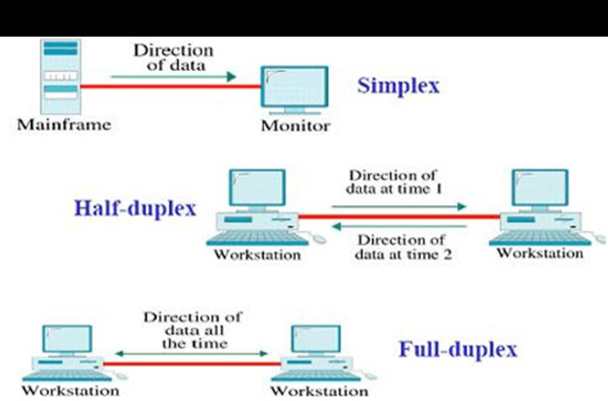
Transmission modes

Slide 39
SPI pins on Arduino Board
SPI uses the following four wires −
SCK − This is the serial clock driven by the master.
MOSI − This is the master output / slave input driven by the master.
MISO − This is the master input / slave output driven by the master.
SS − This is the slave-selection wire.
Active low for data communication else HIGH.

Slide 40
Schematic and direction of data Transfer
MASTER
MICROCONTROLLER
(ARDUINO UNO)
SLAVE
DEVICE
SCK- Serial Clock
MOSI- Master out Slave In
MISO-Master In Slave Out
SS- Slave Select

Slide 41
SPI Modes of Operation
Depending upon Clock Polarity (CPOL) and Clock Phase (CPHA) value.
1. Mode0
2. Mode1
3. Mode2
4. Mode3

Slide 42
Mode 0 (the default) − Clock is normally low (CPOL = 0), and the data is sampled on the transition from low to high (leading edge) (CPHA = 0).
CPOL-0
CPHA-0

Slide 43
Mode 1 − Clock is normally low (CPOL = 0), and the data is sampled on the transition from high to low (trailing edge) (CPHA = 1)
CPOL-0
CPHA-1

Slide 44
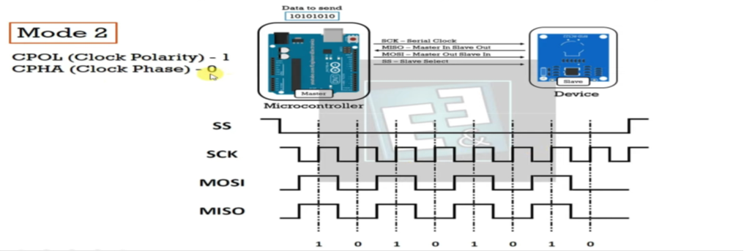
Mode 2 − Clock is normally high (CPOL = 1), and the data is sampled on the transition from high to low (leading edge) (CPHA = 0).
CPOL-1
CPHA-0

Slide 45
Mode 3 − Clock is normally high (CPOL = 1), and the data is sampled on the transition from low to high (trailing edge) (CPHA = 1).
CPOL-1
CPHA-1

Slide 46
Two Arduino UNO Board connection as Master and Slave
(SS) : pin 10
(MOSI) : pin 11
(MISO) : pin 12
(SCK) : pin 13
The ground is common.

Slide 47
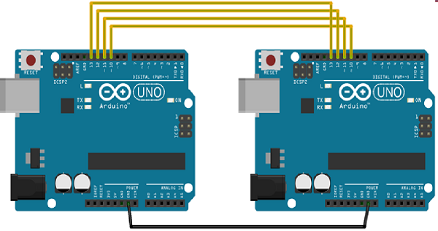
Schematic representation of connection

Slide 48
Functions used in SPI
include the SPI.h library
SPI.begin() − Initializes the SPI bus by setting SCK, MOSI, and SS to outputs, pulling SCK and MOSI low, and SS high.
SPI.setClockDivider(divider) − To set the SPI clock divider relative to the system clock. On AVR based boards, the dividers available are 2, 4, 8, 16, 32, 64 or 128.
The default setting is SPI_CLOCK_DIV4, which sets the SPI clock to one-quarter of the frequency of the system clock (5 MHz for the boards at 20 MHz).

Slide 49
Divider − It could be (SPI_CLOCK_DIV2, SPI_CLOCK_DIV4,SPI_CLOCK_DIV8,SPI_CLOCK_DIV16,SPI_CLOCK_DIV32,SPI_CLOCK_DIV64,SPI_CLOCK_DIV128).
SPI.transfer(val) − SPI transfer is based on a simultaneous send and receive: the received data is returned in receivedVal.
SPI.beginTransaction(SPISettings(speedMaximum, dataOrder, dataMode)) − speedMaximum is the clock, dataOrder(MSBFIRST or LSBFIRST), dataMode(SPI_MODE0, SPI_MODE1, SPI_MODE2, or SPI_MODE3).

Slide 50
SPI as master (example)
#include <SPI.h>
void setup (void)
{ Serial.begin(115200); //set baud rate to 115200 for usart
digitalWrite(SS, HIGH); // disable Slave Select
SPI.begin (); SPI.setClockDivider(SPI_CLOCK_DIV8);//divide the clock by 8 }
void loop (void)
{
char c; digitalWrite(SS, LOW); // enable Slave Select
// send test string
for (const char * p = "Hello, world!\r" ; c = *p; p++)
{
SPI.transfer (c);
Serial.print(c);
}
digitalWrite(SS, HIGH); // disable Slave Select
delay(2000);
}

Slide 51
SPI as Slave
#include <SPI.h>
char buff [50];
volatile byte indx;
volatile boolean process;
void setup (void) {
Serial.begin (115200);
pinMode(MISO, OUTPUT); // have to send on master in so it set as output
SPCR |= _BV(SPE); // turn on SPI in slave mode
indx = 0; // buffer empty
process = false;
SPI.attachInterrupt(); // turn on interrupt
}
ISR (SPI_STC_vect) // SPI interrupt routine {
byte c = SPDR; // read byte from SPI Data Register
if (indx < sizeof buff) {
buff [indx++] = c; // save data in the next index in the array buff
if (c == '\r') //check for the end of the word
process = true;
}
}
void loop (void) {
if (process) {
process = false; //reset the process
Serial.println (buff); //print the array on serial monitor
indx= 0; //reset button to zero
}
}

Slide 53
Digital I/O interfacing

Slide 54
Analog I/O interfacing

